Slide 1
CLASSIFICATION OF SURVEYING
Presentation by,
Name : Dhaval Majithiya
Mechanical Department
Subject: Elements of Civil Engineering
Subject code: 2110004
Roll no.: 204
Amiraj College of Engineering & Technology

Slide 2
Contents:
Surveying- definition
Why classification of surveying is needed?
Classification of surveying- definition
Parts of classification of surveying
Classification based on instruments
Classification based on methods
Classification based on purposes
Classification based on nature of field

Slide 3
Definition: Surveying

Slide 4
Surveying is an art and science of determining the relative positions of various points on the surface of the earth.
By measuring the horizontal and vertical distances, angles and taking the details of these points and by preparing map or plants.

Slide 5
Definition: Classification of Surveying

Slide 6
Surveys can be simplified into various categories depending on the purposes, instruments, methods used and the nature of the field.

Slide 7
Why classification of surveying is important?

Slide 8
So apply these rules in surveying classification is important.
There are some fundamental principals of surveying that..
Always work from the whole to the part, and
To locate a new stations by at least two measurements from the fixed reference points.

Slide 9
Mainly 4 parts of classification:
Classification based on instruments
Classification based on methods
Classification based on purposes
Classification based on nature of field

Slide 10
Classification based on instruments:
There are mainly 9 parts of classification based on instruments.

Slide 11
Chain survey:
This is the simplest type of surveying in which only linear measurement are made with a chain or a tape.
Angular measurements are not taken.

Slide 12
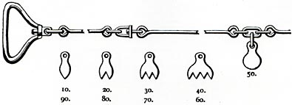

Slide 13
Compass survey
In the compass survey, the angles are measured with the help of a magnetic compass.

Slide 14
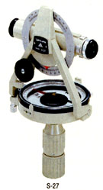

Slide 15
Chain and compass survey:
In this survey linear measurements are made with a chain or a tape and angular measurement with a compass.

Slide 16
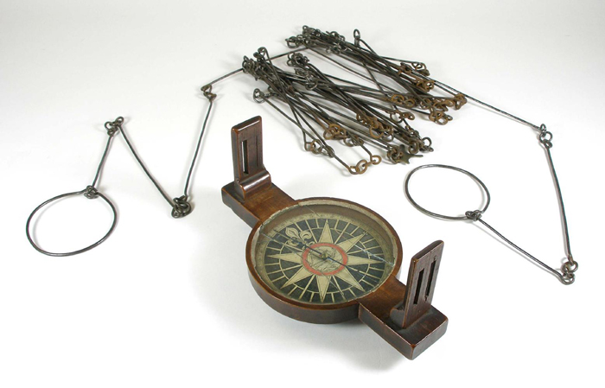

Slide 17
Plane table survey:
It is a graphical method of surveying in which field works and plotting both are done simultaneously.

Slide 18
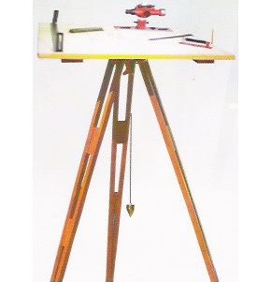

Slide 19
Theodolite survey:
In this survey, the horizontal angles are measured with a theodolite more precisely then compass and the linear measurement are made with a chain or a tape.

Slide 20
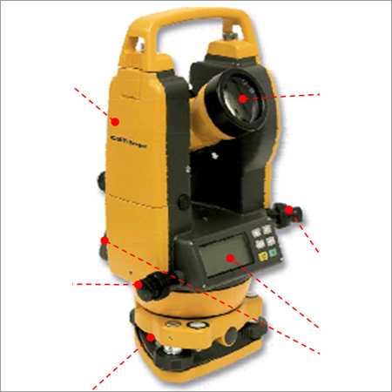

Slide 21
Tacheometry survey:
A special type of theodolite known as a tacheometer is used to determine horizontal and vertical distances indirectly.

Slide 22
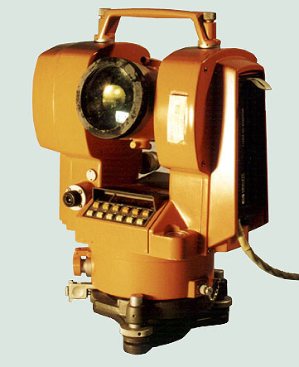

Slide 23
Levelling survey:
This type of survey is used to determine the vertical distances and relative heights of points with the help of an instrument known as level.

Slide 24
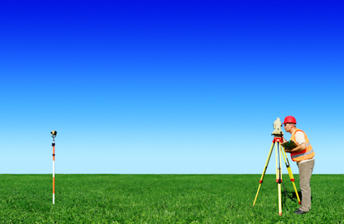

Slide 25
Photogrammetric survey:
Photogrammetry is the science of talking measurements with the help of photographs taken by aerial camera from the air craft.

Slide 26
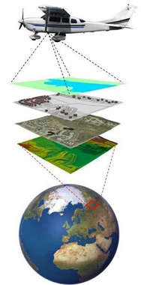

Slide 27
EDM survey:
In this type of survey, all measurements are made with the help of EDM instrument.

Slide 28
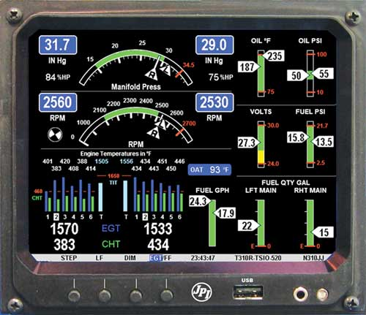

Slide 29
Classification based on methods:
There are mainly 2 parts of classification cased on methods:
Triangulation
traversing

Slide 30
Triangulation:
Triangulation is a basic method of surveying.
When the area is very large then, triangulation is adopted. The entire are is divided into a network or triangles.

Slide 31
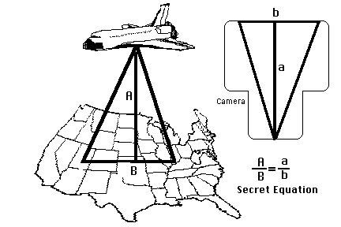

Slide 32
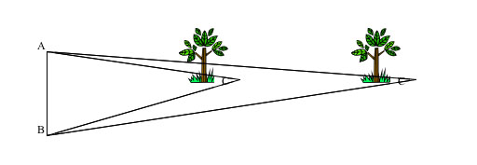

Slide 33
Traversing:
When the linear measurements are done with a chain and tape and the directions or horizontal angles are measured with a compass or theodolite respectively, the survey is called traversing.
A traverse is a circuit of survey lines.

Slide 34
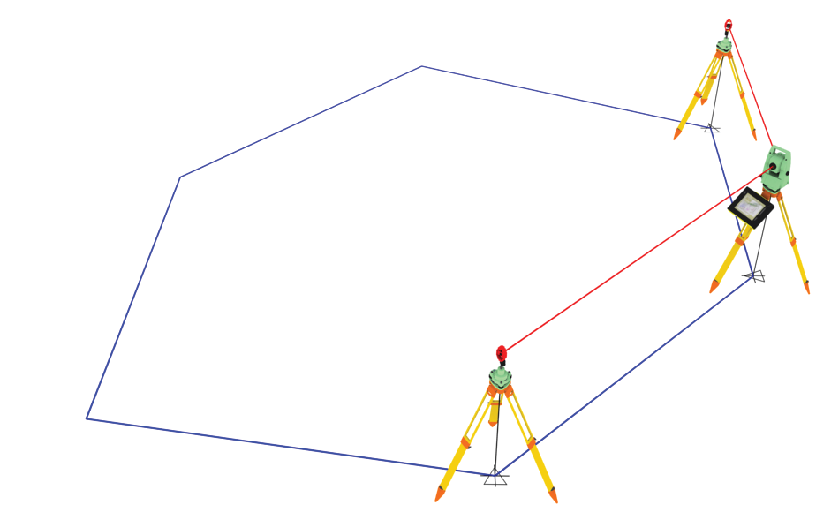

Slide 35
Classification based on purposes:
There are mainly 4 types of classification based on purposes.

Slide 36
Geological survey:
In this both the surfaces and subsurface surveying are conducted to locate different minerals and rocks.
In addition, geological features of the terrain such as folds and faults are located.

Slide 37
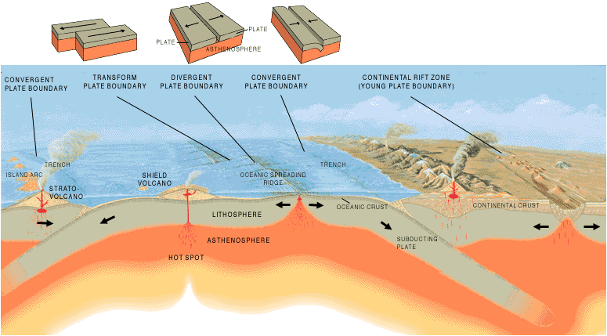

Slide 38
Mine survey:
Mine surveys include both the surfaces and underground surveys.
It conducted for the exploration of mineral deposits and to guide tunneling and other operations associated with mining.

Slide 39
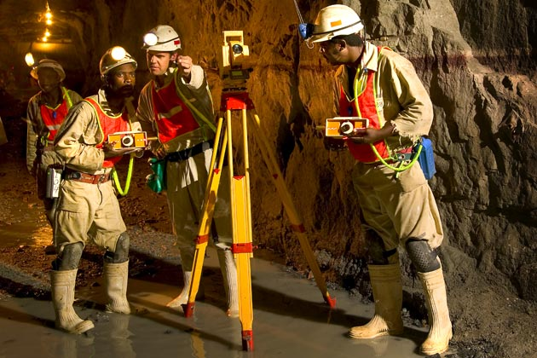

Slide 40
Archaeological survey:
It is conducted to locate relics of antiquity, civilization, kingdoms, forts, temples, etc.

Slide 41
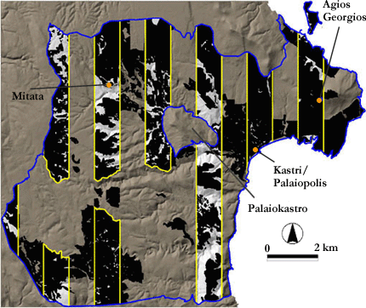

Slide 42
Military survey:
It has a very important and critical application in the military.
Aerial surveys are conducted for this purpose. It is conducted to locate strategic positions for the purpose of army operations.

Slide 43
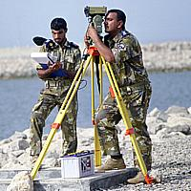

Slide 44
Classification based on nature of field:
There are mainly 3 parts of classification based on the nature of field.

Slide 45
Land survey:
Land survey is done on land to prepare plans and maps of a given area. Topographical, city and cadastral surveys are some of the examples of land surveying.

Slide 46
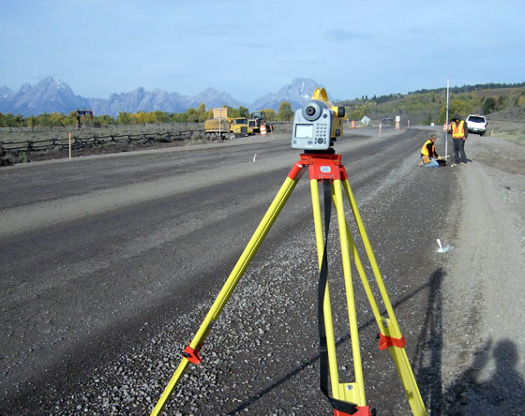

Slide 47
Hydrographic survey:
This survey is conducted on or near the body of water such as lake, river, coastal area. This survey consists of locating shore lines of water bodies.

Slide 48
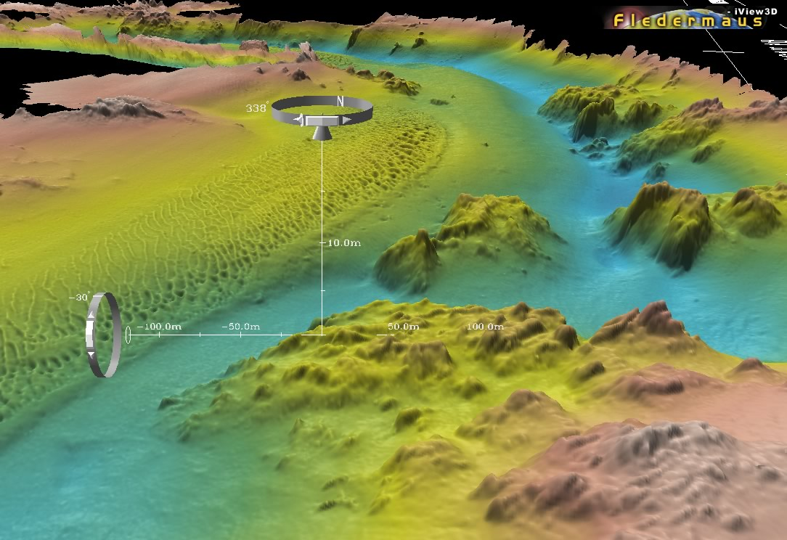

Slide 49
Astronomic survey:
The surveys are conducted for the determination of latitudes, longitudes, azimuths, local time, etc. for various places on the earth by observing heavenly bodies(the sun and stars).

Slide 50
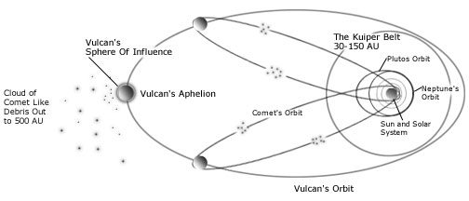

Slide 51
Aerial survey:
An aerial survey is conducted from aircraft. Aerial cameras take photographs on the surface of the earth in overlapping strips of land. This is also known as photographic survey.

Slide 52
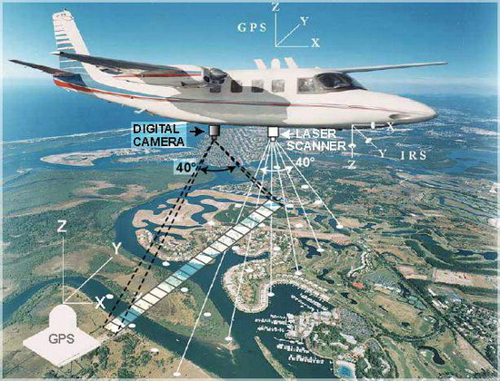

Slide 53
Thank You!

